Slide 1
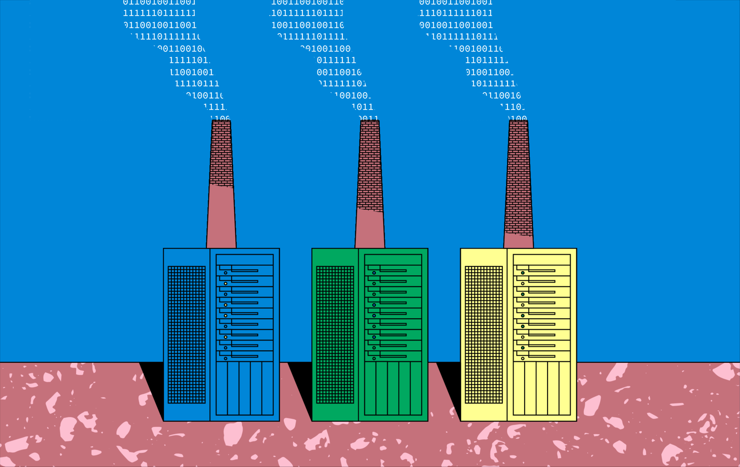
Computing power on demand

Slide 2

Power intensive data centers require a consistent energy source
In 2020, data centers worldwide consumed an estimated 200 TWh.
813 TWh could power the world's data centers for a little over 4 years

Slide 3
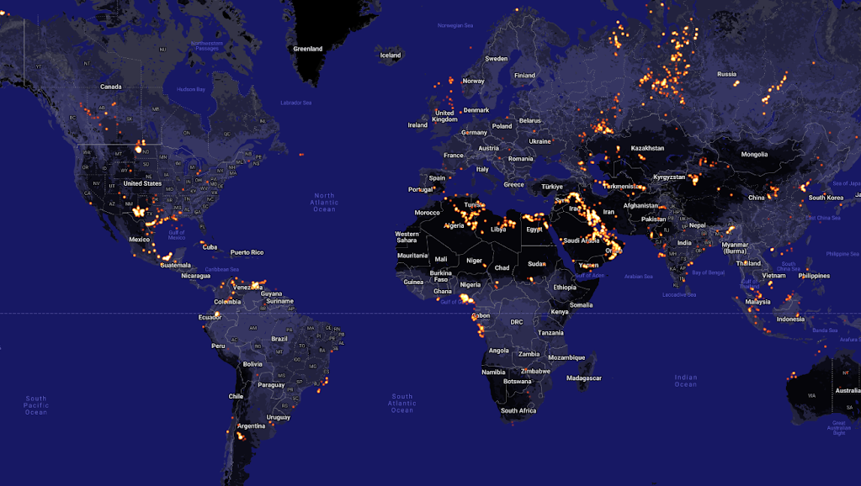
Around
140 billion
cubic meters of natural gas is flared globally each year.

Slide 4
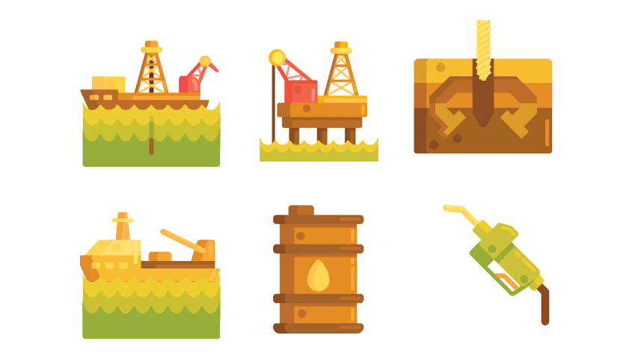
Since oil production mostly happen in stranded locations, the norm in the industry has been burning the gas.
Gas flaring is the burning of natural gas, most notably, Methane (CH4) associated with oil extraction.

Slide 5

Methane has a Global Warming Potential (GWP) that is 34x that of CO2. Making this issue a major sustainability concern.

Slide 6
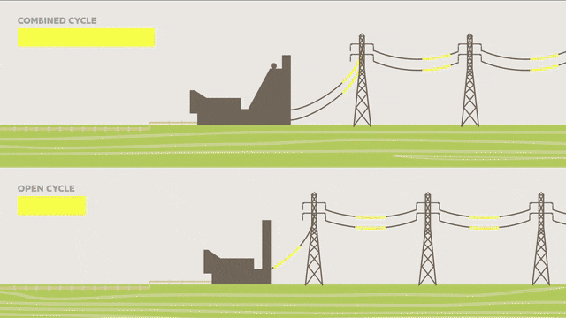
Existing Flare Solutions
On-site power generation:
Gas turbines combust the natural gas to produce hot gases that spin a turbine, generating electricity.
Advantages:
Provides a reliable and continuous power source.
Challenges:
Since oil extraction is mostly done in remote locations, building new transmission lines costs 300,000$ to 3 million $ per mile.
The average cost of storing electricity in lithium -ion batteries is 132$ per kilowatt/hour. An 8 MW transformer is usually installed on smaller scale production sites.

Slide 7
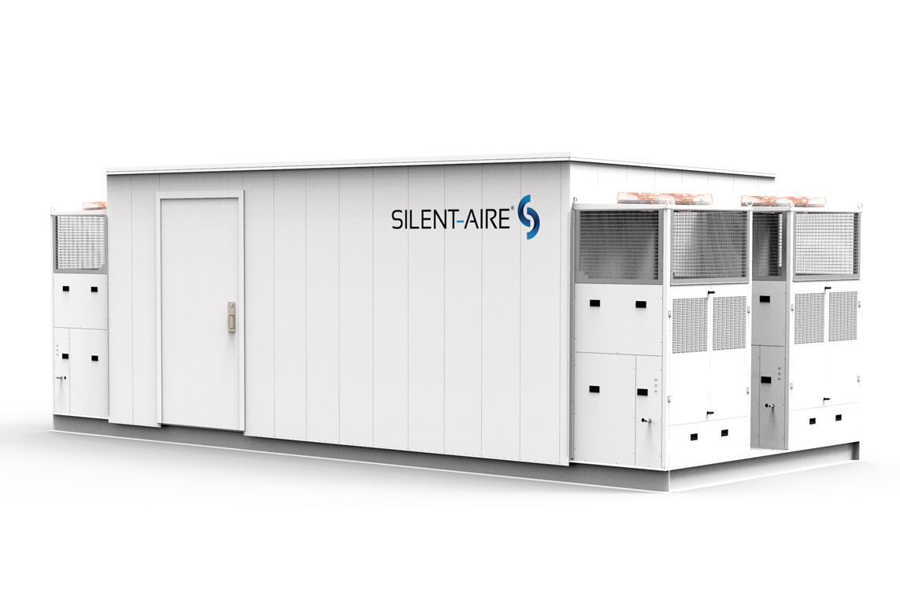
Our solution:
Computing power on demand
Traditional on-site power generation + Modular data centers.

Slide 8
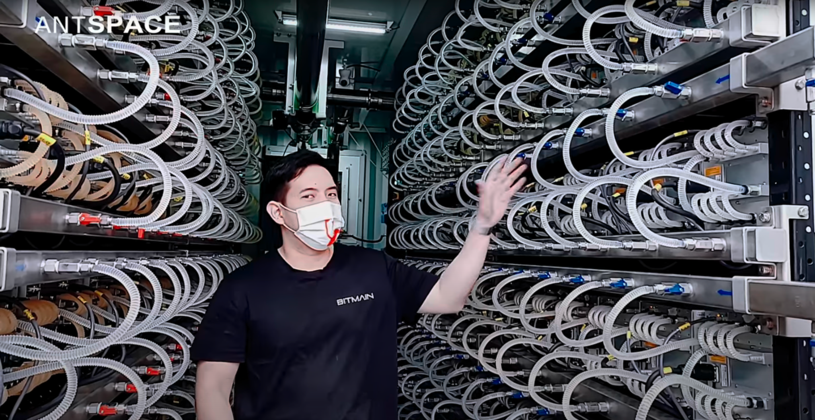

Slide 9
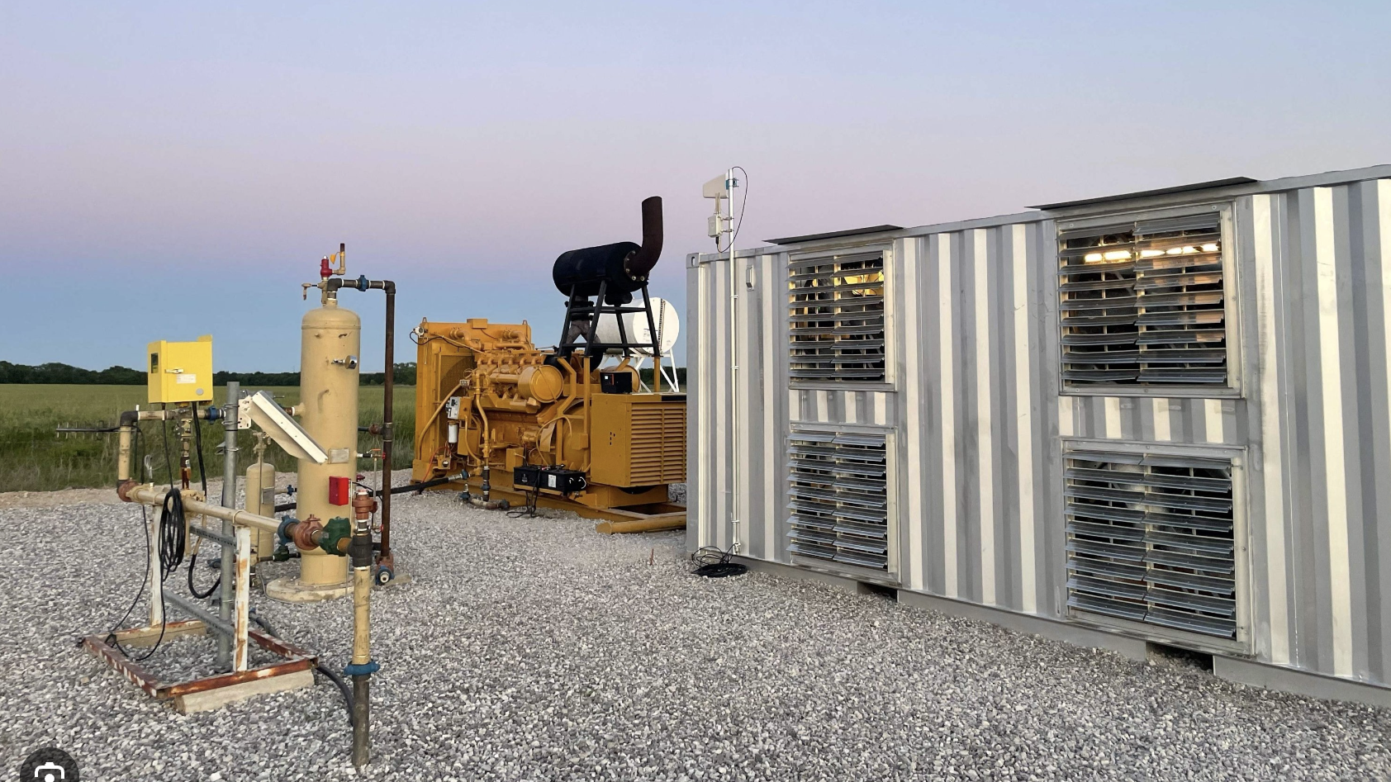

Slide 10

Our Goal
Reducing the carbon footprint of the oil and gas industry, achieving so in an economically feasible manner.
Computing power on demand.
Providing a cost-effective solution for power intensive computing, such as:
Blockchain
AI
Quantum computing

Slide 11




Our solution
Power generation
Energy incentive computing
Waste gas from oil production
Our solution

Slide 12
Advantages
1- Provide an additional stream of income for oil and gas companies.
2- Provide clean and affordable energy for power intensive computing projects.

Slide 13
Solution
Power generation
power intensive computing
Waste gas from oil production
“our app”

Slide 14

The UAE has succeeded in reducing flaring of natural gas from the oil and gas industry since the 1990s and its policy is shifting from minimal flaring to zero-tolerance.

Slide 15


Slide 16

https://www.eia.gov/state/print.php?sid=NY

